Slide 1
CS250 – Introduction to Artificial Intelligence Final Project
Diabetes Prediction using the Pima Indians Diabetes data
UCI Machine Learning Repository
Balaji Venkataraman
12/14/21

Slide 2
Intro to AI – Final Project
Agenda
Motivation for the project
Dataset
Software used
Data processing/cleanup
Data validation
Classification Models & choice
SGDClassifier, RandomForestClassifier
Results
References

Slide 3
Motivation
First AI/ML course for me:
Wanted to learn broader vs. deeper
Goal: Implement my first ML exercise, learn hands-on
Preferred a well-known dataset for my first project
To learn how others show the nuances, modeling methods etc.
Wanted to learn more about Diabetes
Causes, Attributes and Predictive capabilities
Where did I get the idea for the dataset?
Mr. Gheni’s class video pointed to the UCI dataset availability
Perfect class project
Offers learning opportunities in many areas (ML/AI, diabetes)

Slide 4
Dataset
UCI Machine Learning Repository
Pima Indians Diabetes dataset
Credits:
The Pima Indians Diabetes dataset was donated by Vincent Sigillito. The data were collected by the National Institute of Diabetes and Digestive and Kidney Diseases.

Slide 5
Dataset
About the dataset:
Multivariate
Binary Classification dataset
All patients are females (21+ age) of the Pima Indian Heritage
8 features/attributes
Pregnancies
Glucose
BloodPressure
SkinThickness
Insulin
BMI
DiabetesPedigreeFunction
Age
1 outcome
Class of 0: “No diabetes”
Class of 1: “Diabetes”

Slide 6
Software tools
Software used
Anaconda3 – Spyder 4
Python
Libraries: pandas, sci-kit, numpy
Windows x64
Google Colab

Slide 7
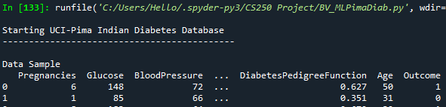
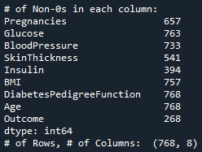
Data processing
Data set:
Rows: 768
Columns: Variables – 8; Values – 1
Has many NaN’s (0’s) in multiple columns
Large # of null values in Insulin and SkinThickness

Slide 8
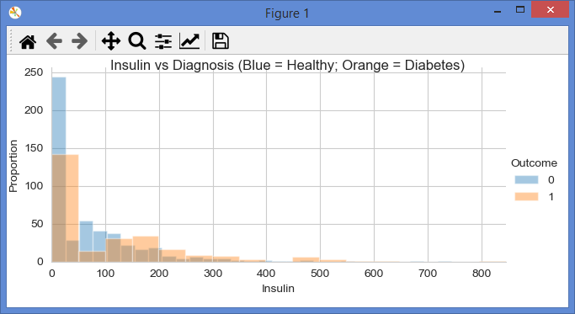
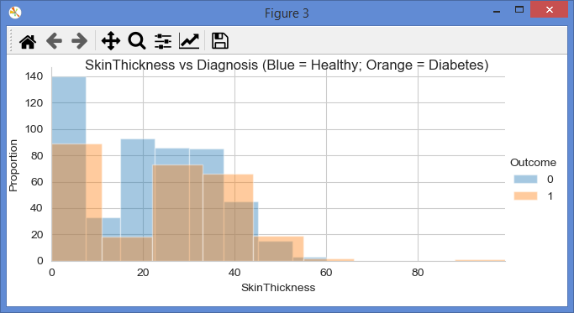
Data validation
Histograms
Large # of 0’s in attributes
For low insulin
For low Skin Thickness
Mostly missing data
Likely some erroneous data
Important to address it
Some 0’s in other attributes
But manageable (low count)

Slide 9
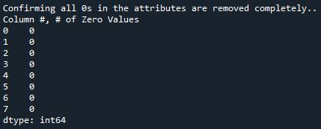
Data validation
The 0’s in the dataset’s attributes must be handled.
Used sklearn’s SimpleImputer
with a ‘Median’ strategy to convert all 0’s
With the imputed data, the model is ready to be trained
Split the dataset 80% training data and 20% test data
A further 20% of the training data was split for validation

Slide 10
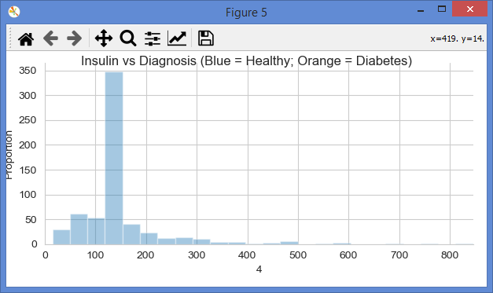
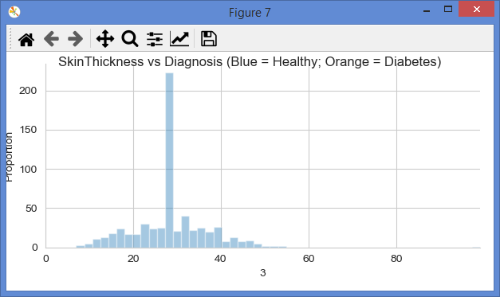
Data validation
Histograms on training set
Large # of 0’s skewed
Within a short range
Insulin
Skin Thickness
Some erroneous data

Slide 11
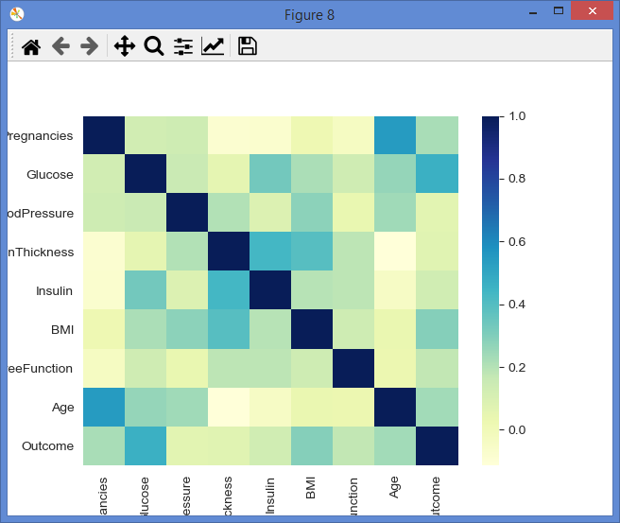
Data validation
Heat map/Correlation
Remarkably perceptive
“Quick & dirty”
Overall, diagonal ok
Stronger correlation seen
BMI
Glucose
Age
Weaker correlation seen
Insulin
Blood Pressure
Skin Thickness

Slide 12
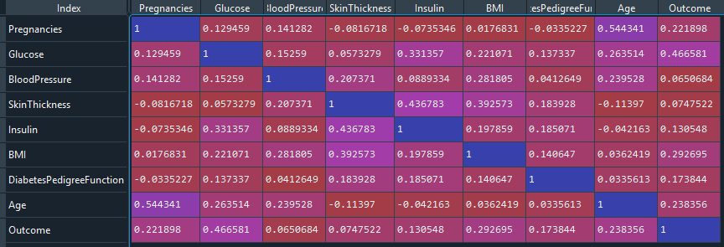
Data processing
Numerical correlation of the Heat map
Mostly independent attributes

Slide 13
Classification Models
“The Unreasonable Effectiveness of data” – Peter Norvig, 1996
“If you make absolutely no assumption about the data, then there is no reason to prefer one model over the other” – David Wolpert, 1996
Yes, may be true; but models/algorithms still make a huge impact
On modeling complex datasets
On accuracy scores & dependable predictions
Especially when data is limited or constrained or erroneous or minimal
2 Classifier models were chosen
Start with a Linear Classifier, then move to more complex algorithms

Slide 14
SGDClassifier
Decided to use Linear Classifier method, SGDClassifier
Stochastic Gradient Descent Classification Ref: Geron book
Wanted to learn step-by-step how to apply a Linear Classifier
“This estimator implements regularized linear models with stochastic gradient descent (SGD) learning: the gradient of the loss is estimated each sample at a time and the model is updated along the way with a decreasing strength schedule (aka learning rate). SGD allows minibatch (online/out-of-core) learning via the partial_fit method. For best results using the default learning rate schedule, the data should have zero mean and unit variance.” – Ref: Scikit-learn.org
Aim was to get the model working in Python/Spyder
Used kaggle for help along the way

Slide 15
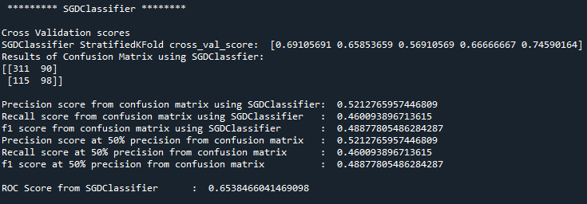
SGDClassifier
Performed Cross validation with the training dataset
With Stratified Kfolds, 5 sets
0.57 to 0.75 cross validation scores

Slide 16
SGDClassifier
Ran Confusion Matrix with the model fit with SGDClassifier
98 True-Positives, but 90 False-Positives
Only 52% Precision at 46% Recall
Less than optimal results
F1 score 49%

Slide 17
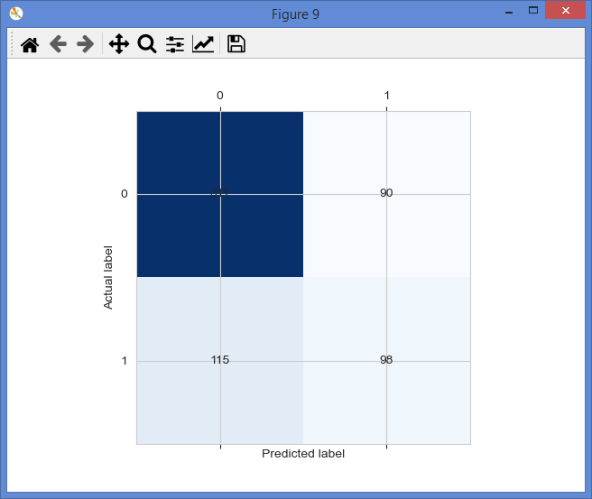
SGDClassifier
Confusion Matrix with SGDClassifier
Needs improvement
98 True-Positives
..but 90 False-Positives
Also, 115 False-Negatives
Not good
Improvement needed..
Recall
Accuracy

Slide 18
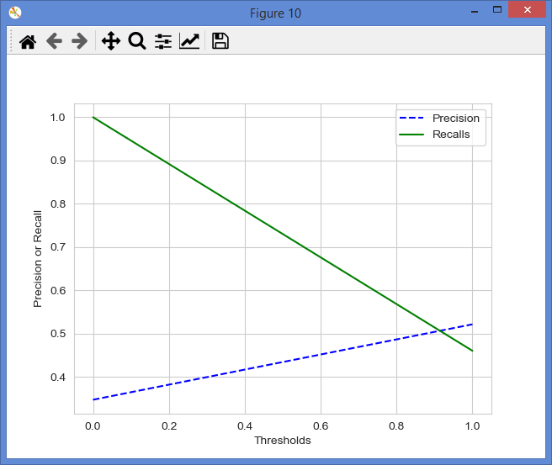
SGDClassifier
Decision thresholds
Precision vs. Recall
Not so good fit
Shows best value ~ 52%
Either Recall or Precision
ROC score ~65%
Definitely needs another
Model for comparison!!

Slide 19
RandomForestClassifier
Chose RandomForestClassifier
Primarily to improve the fit for better:
Precision vs. Recall
Stats on the Confusion Matrix (FP or FN were high with SGDClassifer)
Modeling accuracy (SGDClassifier was at 52%)
A random forest classifier.
“A random forest is a meta estimator that fits a number of decision tree classifiers on various sub-samples of the dataset and uses averaging to improve the predictive accuracy and control over-fitting. “- Scikit-learn.org

Slide 20
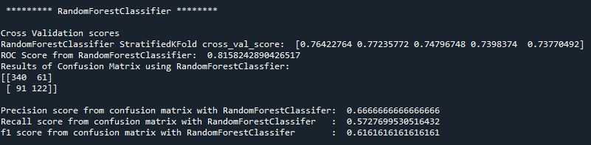
RandomForestClassifier
Performed Cross validation with the training dataset
With Stratified Kfolds, 5 sets
Improved Cross validation scores of 0.7 – 0.77
Improved ROC scores of 0.81 (vs. 0.65 with SGD)

Slide 21
RandomForestClassifier
Ran Confusion Matrix with the model fit with SGDClassifier
122 True-Positives
Definite Improvements over SGD
Only 67% Precision at 57% Recall
Much better than SGD, but still can be better….
F1 score 61%

Slide 22
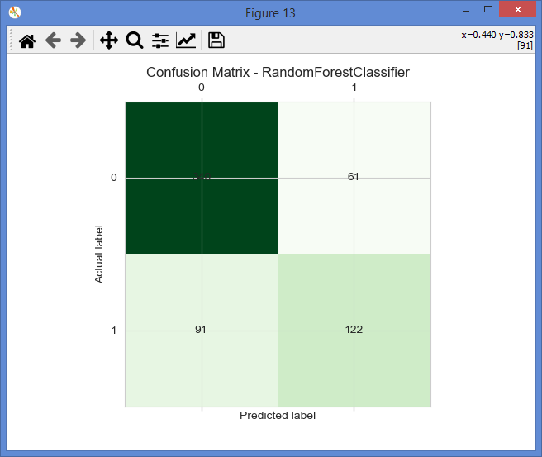
RandomForestClassifier
Confusion Matrix with RandomForestClassifier
122 True-Positives,
but 61 False-Positives
& 91 False-Negatives
A lot better than SGD…
… but could be better!!

Slide 23
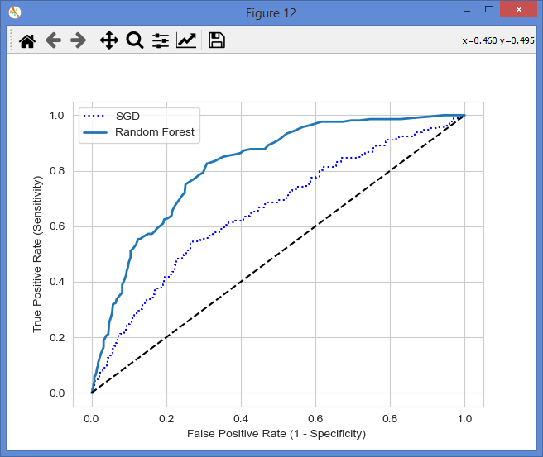
Comparison of Models
ROC-AUC curve for RandomForest vs SGD
Shows large improvements
This leads to better results

Slide 24
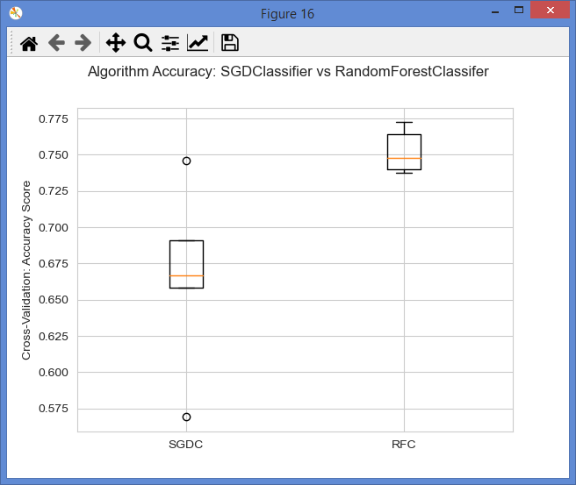
Comparison of Models
For the same training dataset:
RandomForestClassifier has:
Confusion Matrix results
Precision vs Recall
F1 score
And Accuracy
cross_validation scores
Superior to SGDClassifier

Slide 25
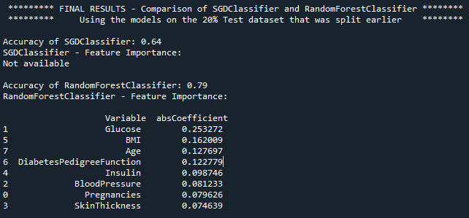
Results
Final Results
RandomForestClassifier
Applied on Test data that was split from the Training data
Accuracy of 79% vs SGDClassifier’s Accuracy of 64%

Slide 26
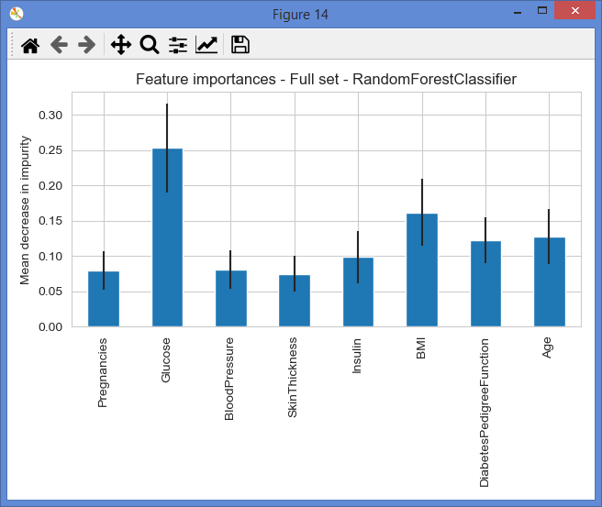
Results
Feature Importance with RandomForestClassifier
Full set (all attributes)
Top Prediction criteria
Glucose (2-hour serum test)
BMI (Body Mass Index)
Age
Low Prediction attributes
Blood pressure
Skin thickness
Pregnancies

Slide 27
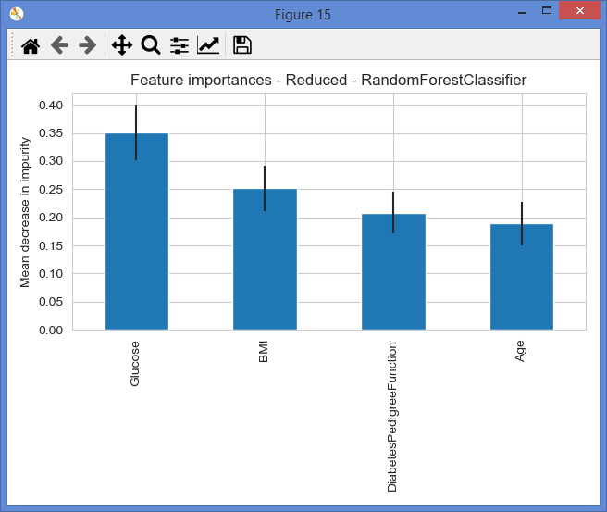
Results
Feature Importance with RandomForestClassifier
Reduced set (few attributes)
Removed attributes
Blood pressure
Skin thickness
Pregnancies
Insulin levels
Still, accuracy is 77%

Slide 28
Results
Overall, ~80% accuracy for Diabetes predictions is nice!
Despite limited data, modeling challenges, some erroneous data..
RandomForestClassifier wins!

Slide 29
Conclusion
Extraordinary learning
About Machine Learning & AI
Classification models, their pros, limits and user responsibilities
About Diabetes
Impact of Glucose levels, BMI and Insulin on Type II Diabetes
Importance of early prediction
Currently, studying a 2nd database reg HbA1c (Strack - UW)
Humbled by the advances made in this area
Power of software tools (Python, Libraries)
Thanks for assigning a great project opportunity!

Slide 30
References
Aurélien Géron, Hands-On Machine Learning with Scikit-Learn, Keras, and TensorFlow: Concepts, Tools, and Techniques to Build Intelligent Systems. 2nd edition O’Reilly, 2019. ISBN-13: 978-1492032649
Beata Strack, Jonathan P. DeShazo, Chris Gennings, Juan L. Olmo, Sebastian Ventura, Krzysztof J. Cios, John N. Clore, "Impact of HbA1c Measurement on Hospital Readmission Rates: Analysis of 70,000 Clinical Database Patient Records", BioMed Research International, vol. 2014, Article ID 781670, 11 pages, 2014. https://doi.org/10.1155/2014/781670
https://www.kaggle.com/paultimothymooney/predict-diabetes-from-medical-records/notebook
https://archive.ics.uci.edu/ml/support/diabetes
https://archive.ics.uci.edu/ml/datasets/diabetes
http://archive.ics.uci.edu/ml/datasets/Pima+Indians+Diabets
https://scikit-learn.org/stable/modules/generated/sklearn.linear_model.SGDClassifier.html#
https://scikit-learn.org/stable/modules/generated/sklearn.ensemble.RandomForestClassifier.html
Very helpful additional references
https://scikit-learn.org/stable/auto_examples/ensemble/plot_forest_importances.html
https://stackoverflow.com/questions/20998083/show-the-values-in-the-grid-using-matplotlib
https://scikit-learn.org/stable/auto_examples/model_selection/plot_confusion_matrix.html
https://pandas.pydata.org/docs/reference/api/pandas.DataFrame.count.html
https://scikit-learn.org/stable/modules/generated/sklearn.impute.SimpleImputer.html
http://www.google.com

